Slide 1
When mistaking “car tyre” for “Kaitaia” is not okay – Towards quantifying language bias in speech technology
ECSE Project #18
Louis Chuo & Henry An
Supervisors: Jesin James & Josh Bensemann

Slide 2
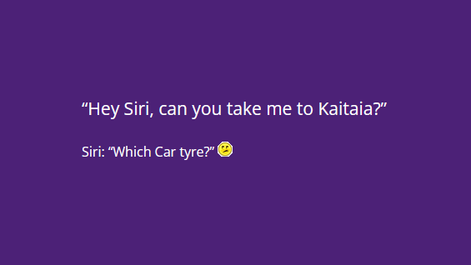

Slide 3
Overview
Motivation
Background
Current methods for addressing accent bias
Project Scope & Plan
Research Intent and Objectives

Slide 4
Motivation
Speech Recognition is currently being widely used in the world.
Current systems aren’t the most accurate in interpreting accented speech.
Forces people to learn a new language or imitate a new accent to use technology – people who need technology for accessibility are disadvantaged

Slide 5
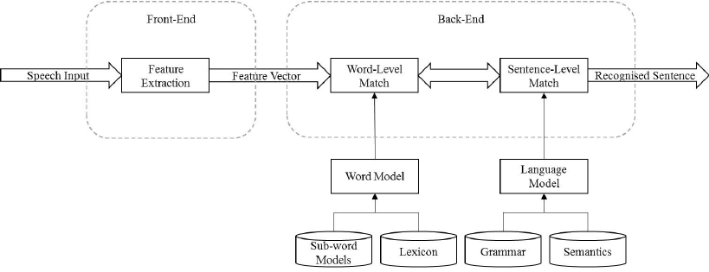
Background
What is Automatic Speech Recognition (ASR)?
Technology that allows voice to be used as an input for information
Typically uses Machine Learning to be able to properly translate speech
Used in speech-to-text services, virtual assistants, even voice biometry
Figure: A Simple Automatic Speech Recognition Block Diagram^{[1]}
L. R. Rabiner and B.-H. Juang, Fundamentals of Speech Recognition vol. 14: PTR Prentice Hall Englewood Cliffs, 1993.

Slide 6
Background
What is Accent Bias?
Per the Oxford dictionary, Accent is defined as “a distinctive way of pronouncing a language, especially one associated with a particular country, area, or social class.”
Example: NZ English vs US English vs Australian English
Bias we define in terms of it being used in Machine learning

Slide 7
Background
What is Machine Learning Bias?
Machine Learning needs a set of data to “learn”
What happens if this data is skewed in one aspect or another?
The algorithm produced inherits the skew of the data
This skewed algorithm produces biased results, favouring certain outcomes
For ASR, some accents are recognised better than others

Slide 8
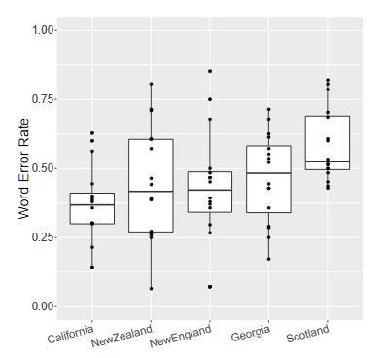
Background
Figure: YouTube automatic caption word error
rate by speaker’s dialect region.^{[2]}
Word Error Rate = 1- Correct Words/ Total Words
Lower values are better
Higher WER for non standard English Accents
NZ English has a greater variability, slightly higher average WER
2. R. Tatman. "Gender and dialect bias in YouTube’s automatic captions." In Proceedings of the first ACL workshop on ethics in natural language processing, pp. 53-59. 2017.

Slide 9
Project Plan
Commercial & Existing ASR Models
Word Error Rate Calculation
“Ground Truth” Results
NZ English Datasets
Compare
Custom ASR Model
Word Error Rate Calculation
Custom ASR Results

Slide 10
Current Methods for Minimising Accent Bias
Single Model System
Ensembling - train multiple ASR models then combines results
Sequence to Sequence - map input speech sequence to text output sequence
Multitask modelling - solve multiple learning tasks same time

Slide 11
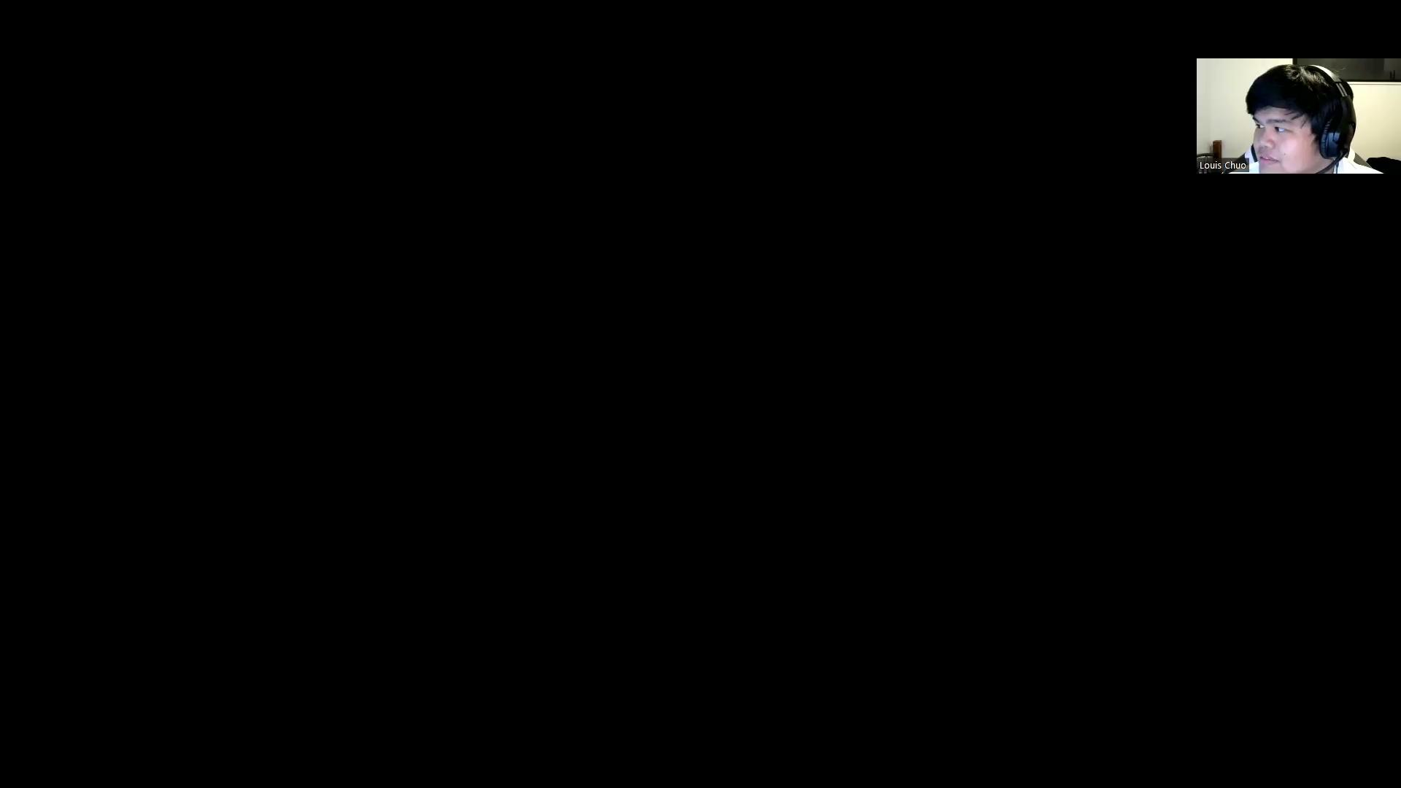

Slide 12
Current Stage
Thanks For Listening!
Measuring Bias in current systems
Comparing Word Error Rates of different commercial ASR systems (Google, Amazon)
Commercial & Existing ASR Models
Word Error Rate Calculation
“Ground Truth” Results
NZ English Datasets
Compare
Custom ASR Model
Word Error Rate Calculation
Custom ASR Results

Slide 13
Current Methods for Minimising Accent Bias
Use accent detection, then use pre-trained accent models for recognition
Advantages:
Pre-trained models for that accent ensure accuracy
Problems:
Accents recognizable are limited to the amount the system can handle
Need large amounts of space for storing multiple trained neural models
Accents with less data available cannot be represented accurately
Figure: Accent Classifier with Pre-trained Models^{[3]}
Pre-trained Model #1
Accent Classifier
Translated Speech
Pre-trained Model #2
Speech
3. C. Huang, T. Chen, and E. Chang, “Accent issues in large vocabulary continuous speech recognition.” International Journal of Speech Technology. 7(2):141-53, April 2004.

Slide 14
Current Methods for Minimising Accent Bias
Dual Model system
Two systems, Accent classification and embedding extraction
Divergence of accented speech is detected and quantified to embeddings
Embeddings are used to introduce “bias” to the normal system
Solves problem as model is now dynamically trained
Figure: A Dual Model Accent-aware ASR System^{[4]}
Translated Speech
Accent Classifier
Main ASR System
Embedding extraction
Speech
4. A. Jain, M. Upreti, and P. Jyothi. "Improved Accented Speech Recognition Using Accent Embeddings and Multi-task Learning." In INTERSPEECH, pp. 2454-2458. 2018.

Slide 15
Why the NZ English accent?
Research should be conducted from NZ by NZ English speakers as we are the most affected
Comprehensive datasets are available to be used to represent NZ English
Frequently underrepresented in training data
NZ has around 4.9 million currently (US has 332 million by comparison)
Big companies do not have much monetary incentive to invest in research
Time constraints limit the scope

Slide 16
Desired Project Output
Comercial ASR Models
Word Error Rate Calculation
“Ground Truth” Results
NZ English Datasets
Compare
Custom ASR Model
Word Error Rate Calculation
Custom ASR Results

Slide 17
Research Intent
Can we improve an ASR model to be more accurate at recognising New Zealand English accented speech using linguistic analysis to provide bias compensation?
What is the accuracy of current speech recognition systems on the NZ accented speech?
What is an appropriate quantitative measure for identifying errors in current Speech Recognition Systems?
How can the accuracy of ASR systems be improved with regards to recognition of the NZ English accented speech?

Slide 18
Research Objectives
Research on any current open-source Speech Recognition projects that we can use to build upon
Determine how the NZ English accent is performing on currently available systems
Find current results on different projects for our results to compare upon
Research on current methods for how ASRs are interpreting accents
Research on other methods of quantifying accents that may have not been implemented on current ASRs
Determine the best suited method for quantifying the errors due to accented speech

Slide 19

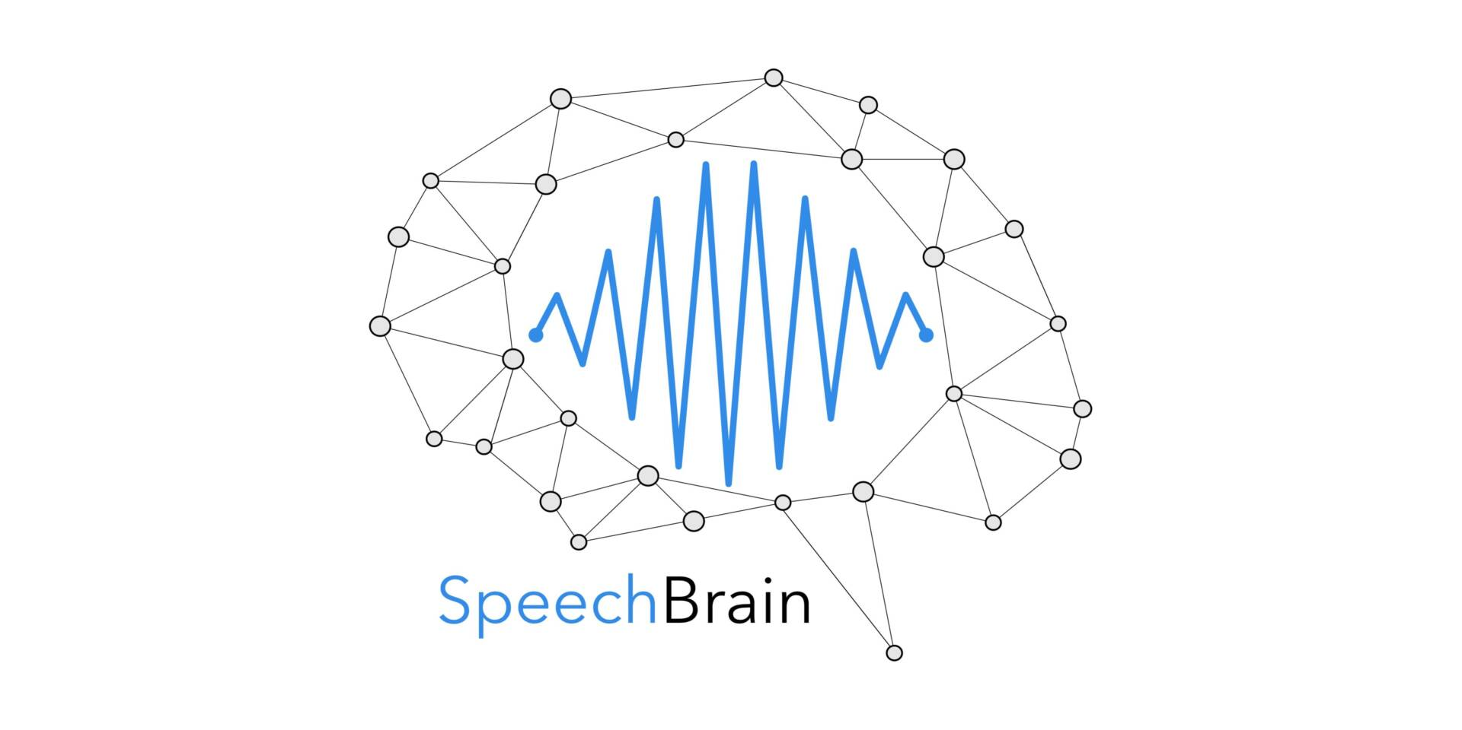

Speech Recognition Toolkits
Toolkit | Base Framework | Main Advantages
Vosk | Kaldi | Portability, ease of use
SpeechBrain | PyTorch | In active development, flexibility
FairSeq | PyTorch | Comprehensive, well-documented

Slide 20
Databases being used
Database Name | Is Open Source? | Base Accent | Number of Lines | Metadata
JLCorpus | Yes | NZ English | 2,400 | Emotion, Gender
Mozilla Common Voice | Yes | International English | 81,085 | Gender, Age, Accent
Mansfield Corpus | No | NZ English | 2,693 | 2 Females, 2 Males

